Slide 1

MyJobCorps
MyJobCorps Overview
Briefing for Center IT POC’s
July 17, 2024

Slide 2



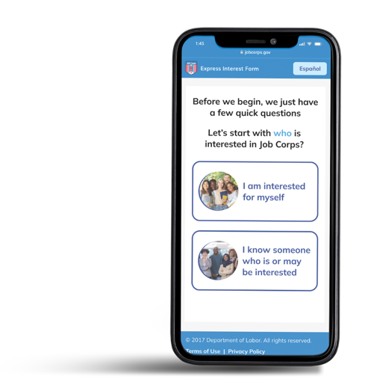
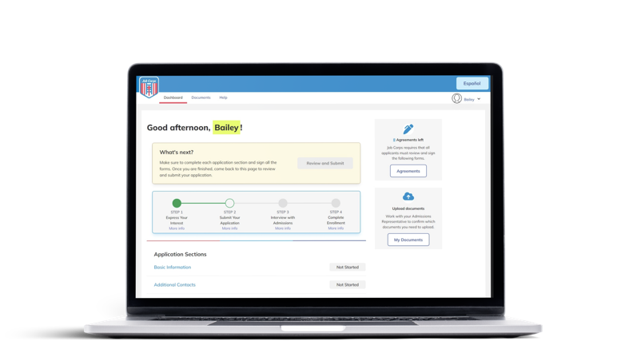
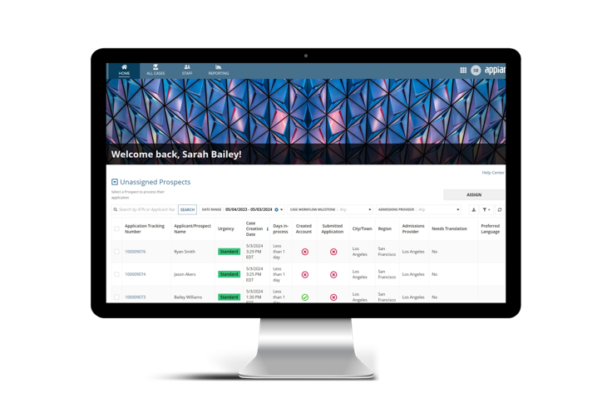
MyJobCorps Platform Tools
Consistent with the Administration’s efforts to help more young people access good paying jobs, MyJobCorps empowers youth and young adults to take control of their Job Corps enrollment journey.
MyJobCorps streamlines practice, process, and technology by providing the following integrated systems for young people and Job Corps admissions staff.
Express Interest Tool
MyJobCorps Portal
MyJobCorps Gateway
Express Interest in Job Corps
Apply and Submit Application
Process Enrollment
Interested applicants provide their contact information online.
Allows future students to apply, upload documents, and sign agreements.
Streamlines and automates case management and processing activities for Admissions Staff.

Slide 3
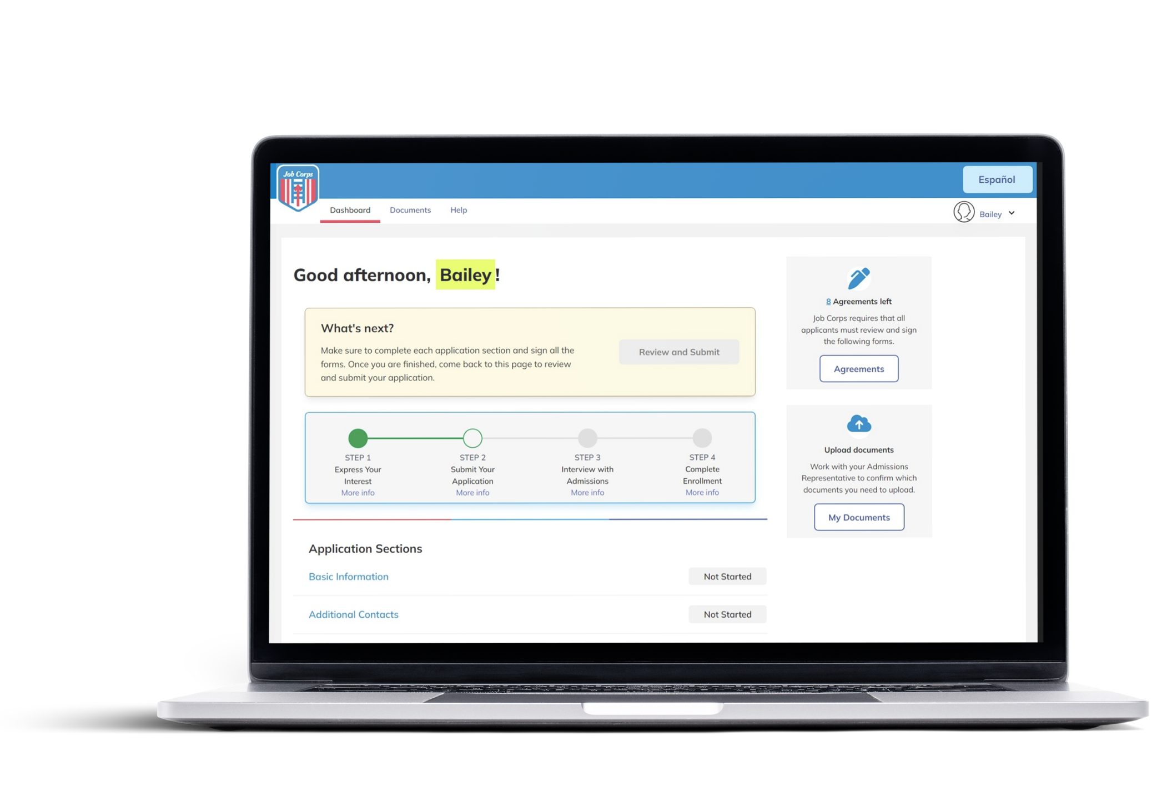
MyJobCorps Portal – Modernizing how future students apply
MyJobCorps Portal
MyJobCorps Portal modernizes the application process for future students by providing an online system where they can apply on their own from any device on their own time and/or with the support of an Admissions Representative.
  Securely apply online from any device
  Upload and digitally sign forms
  Track application progress
  View and receive automated application status updates

Slide 4
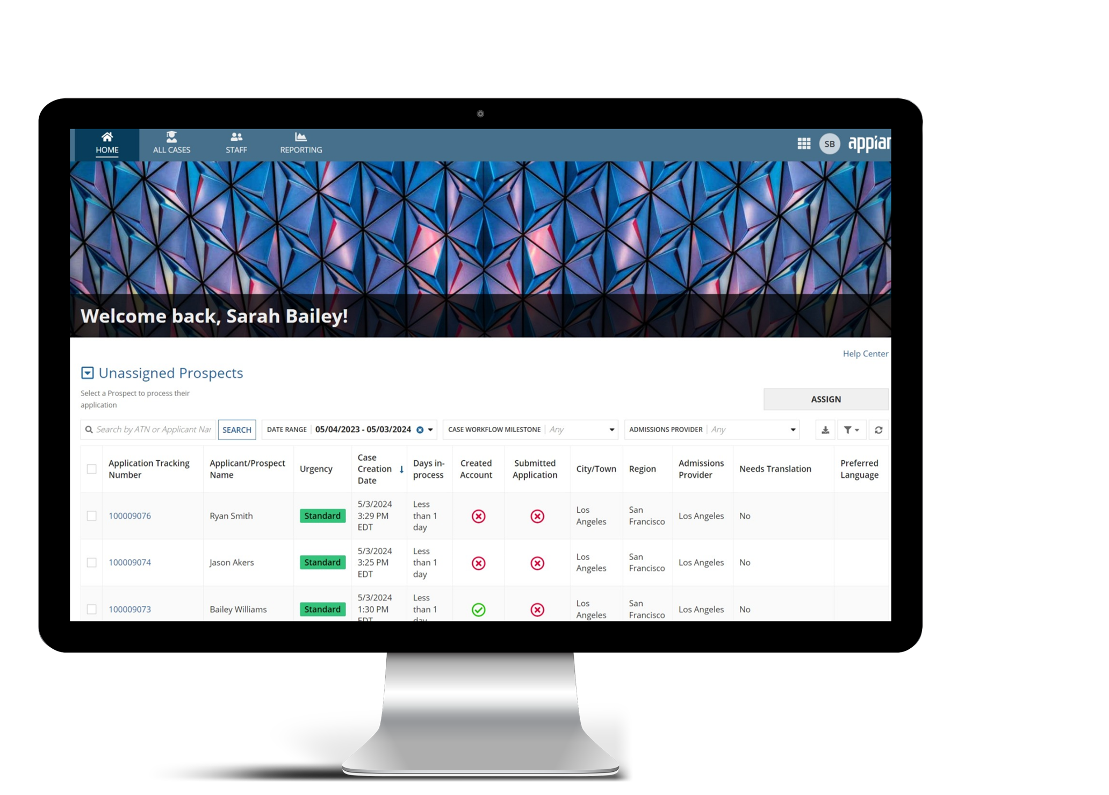
MyJobCorps Gateway – Transforming application processing
MyJobCorps Gateway
MyJobCorps Gateway transforms the legacy process and system– providing a system-based workflow process with smart automation that standardizes the admissions process.
  Integrated, dedicated case management tool
  Automated, standardized workflow, with validation points based in policy
  Milestone tracking enabled (track status and receive updates)
  Decreased processing time

Slide 5
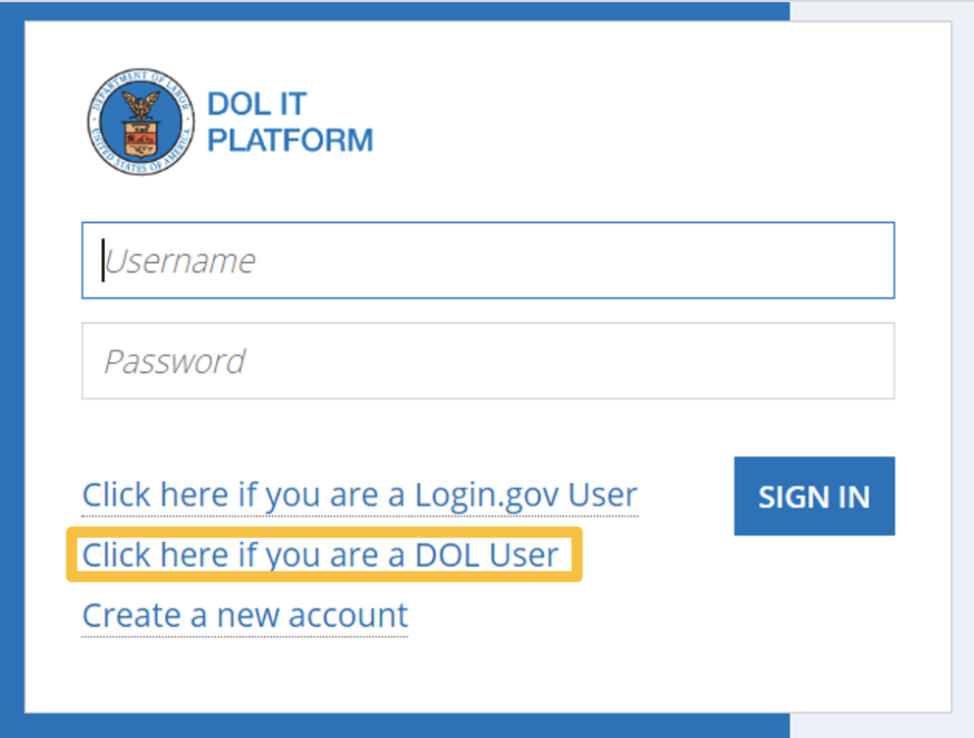
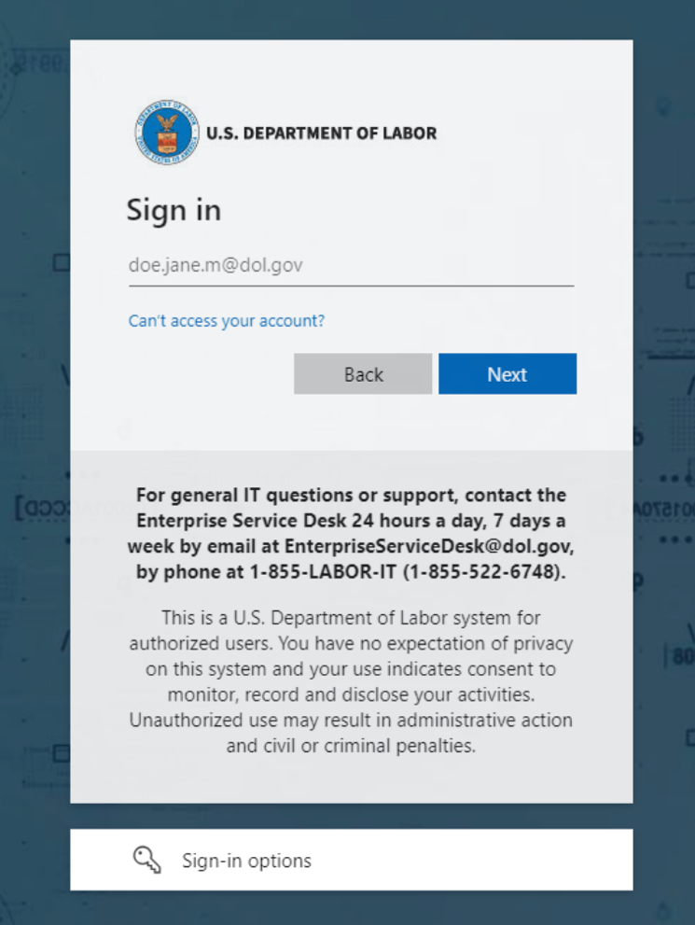
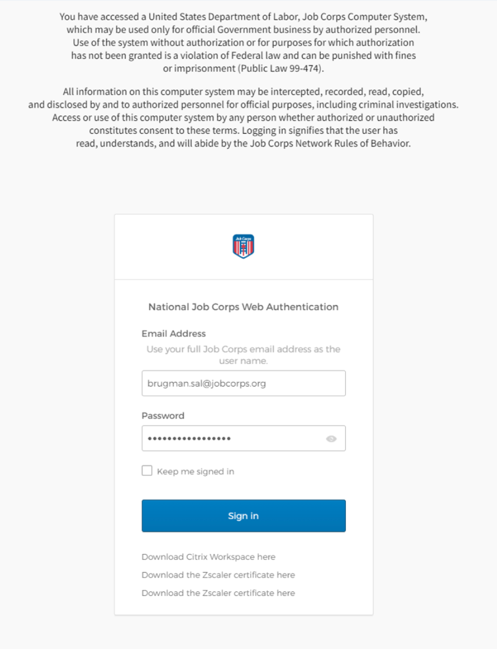
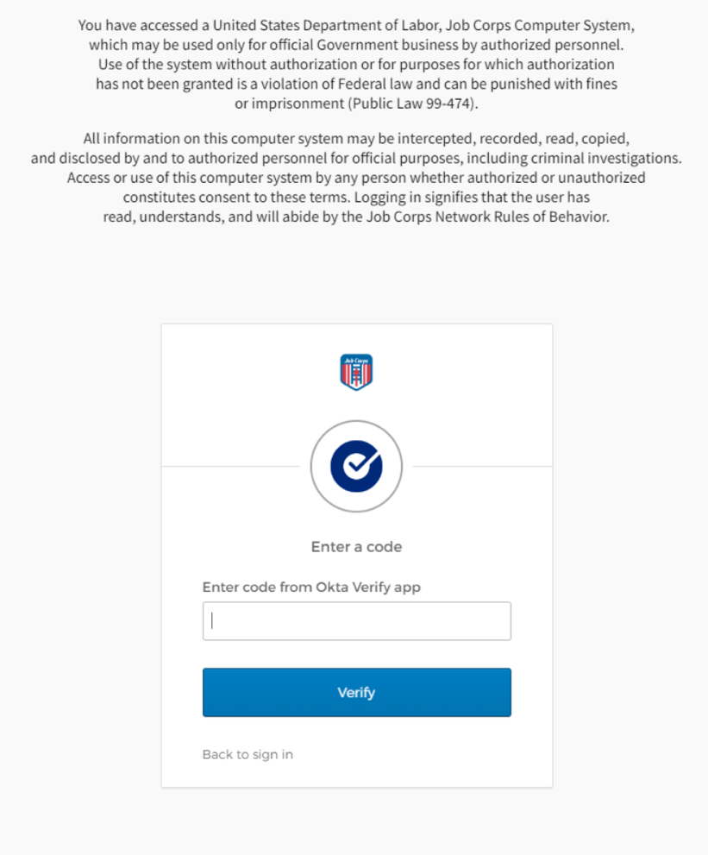
Common IT Questions
The MyJobCorps team will create MyJobCorps accounts for all existing staff. Accounts will be created for new staff after the ID Auto form is completed and sent to JCDC.
Staff logs in as DOL users, using Okta Verify to login. If users are having issues logging in due to OKTA Verify, they will need to follow the directions laid out by JCDC.
  Note: Accounts deactivate if users do not login for 60 days.
cmp.dol.gov
Log into MyJobCorps Gateway

Slide 6
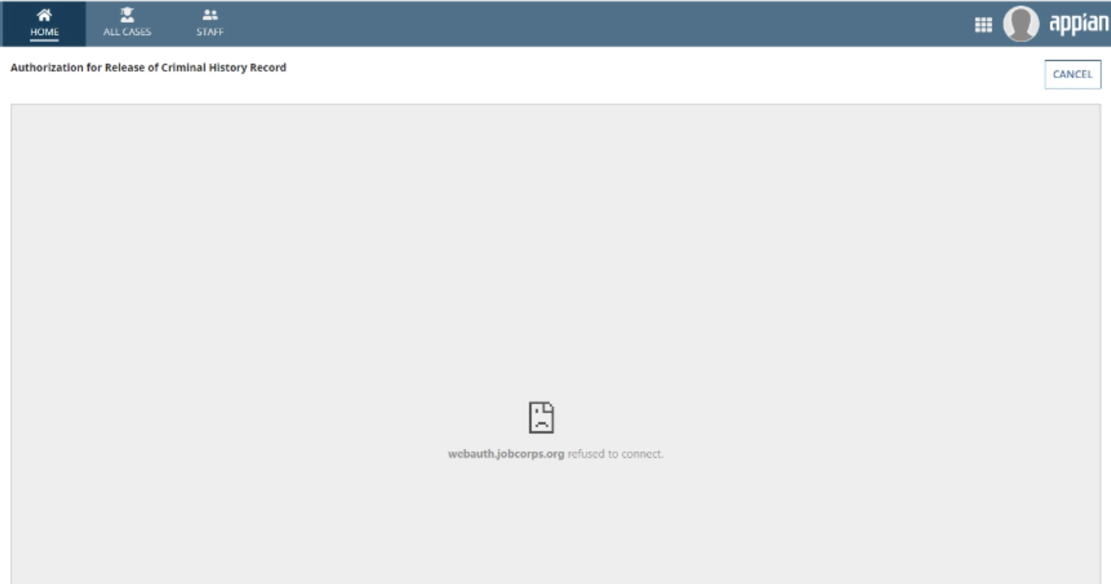
Common IT Questions, continued.
Admissions staff have, on occasion, encountered an error when opening PDF documents within MyJobCorps Gateway. When staff tries to opens the document, the message “webauth.jobcorps.org refused to connect” displays.
If staff encounter this error, they need to update their default app settings to Adobe Acrobat/Reader for PDF files.
Steps to Update Default App Settings
Go to settings (it looks like a cog on a Windows computer).
Select Apps.
Click on “Default apps.” Note: You can skip steps 1-3 by searching “default apps” in the Windows search bar.
Select “Choose apps by file type”.
Scroll down to .pdf and click on the app on the right. Select Adobe Acrobat Reader or Adobe Acrobat.
Restart your computer and try to view the files again.
What should I do if I can’t open documents in the Gateway?

Slide 7
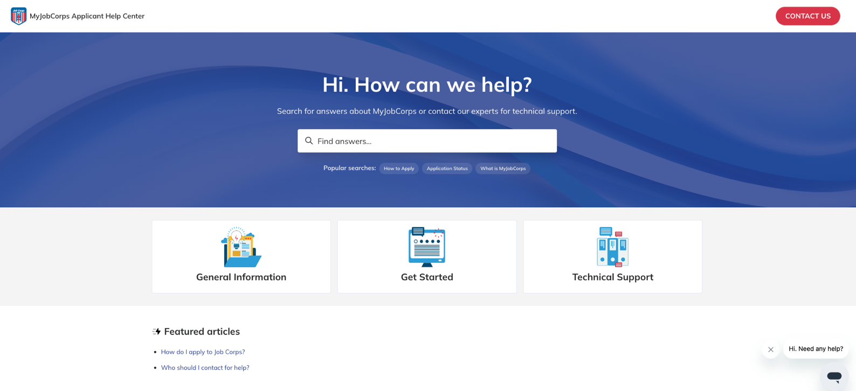
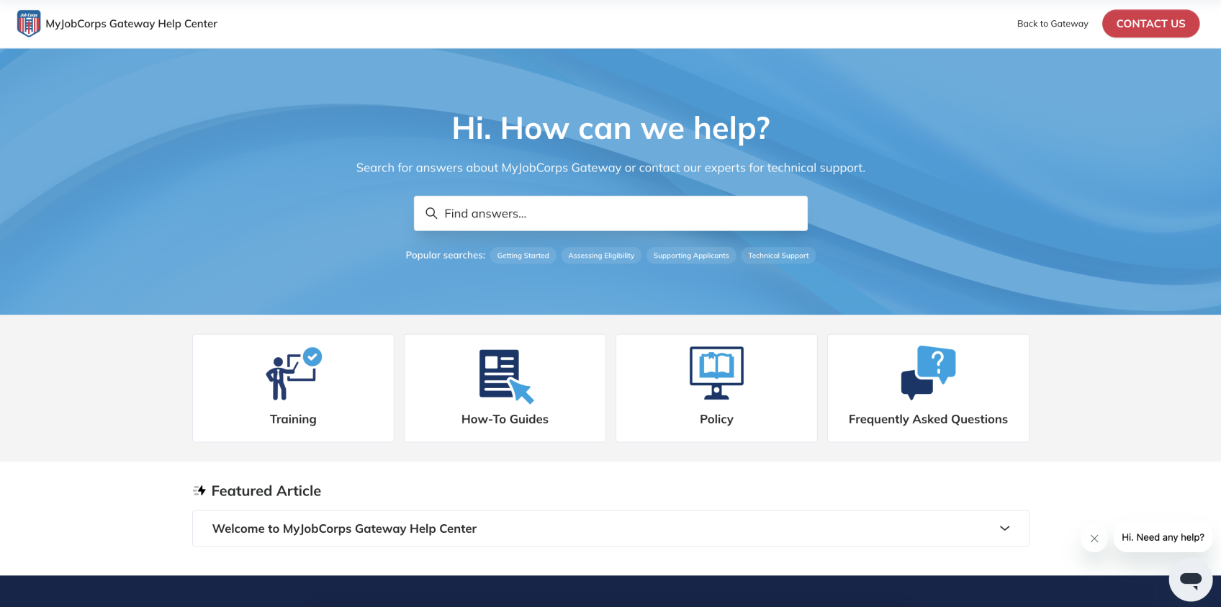
Training, Help Desk, and Support Resources
The MyJobCorps Help Desk is available Monday-Friday from 7am-7pm Eastern time. The Help Desk also includes dedicated online resources for Prospects/Applicants and for Admissions Staff to get access to training materials, frequently asked questions, and technical support.
If Admissions Staff asks questions that Center IT Staff cannot assist with, please direct their questions to the MyJobCorps Help Desk.
MyJobCorps Applicant Help Center
MyJobCorps Gateway Help Center
https://enrollmenthelp.jobcorps.gov/hc/en-us
https://gatewayhelp.jobcorps.gov/hc/en-us
Applicants can access:
Self-help knowledge base
How do I apply to Job Corps guide
Getting Started with MyJobCorps video
FAQs related to the application process
Interactive chatbot
Technical Support
Admissions staff can access:
Recorded Trainings
Instructional guides and videos
Policy guidance
FAQ’s and more
Interactive chatbot and live chat support
Technical Support

Slide 8

Questions

Slide 9
MyJobCorps
Thank you!
MyJobCorps Support Team
Office of Job Corps | JobCorps.gov
Employment & Training Administration (ETA)
U.S. Department of Labor
Email us at: MyJobCorps@dol.gov

