Slide 1

MyJobCorps
MyJobCorps
Micro-Training
3.1 Updates and Enhancements
Early Adopters
July 23, 2024

Slide 2
Agenda
Overview of 3.1 Features and Enhancements in Gateway available Friday, July 26th
  Enhanced Navigation
  Application Verification
  Document Repository
  Updated Reporting
  Updated Event Tracking
Q&A

Slide 3

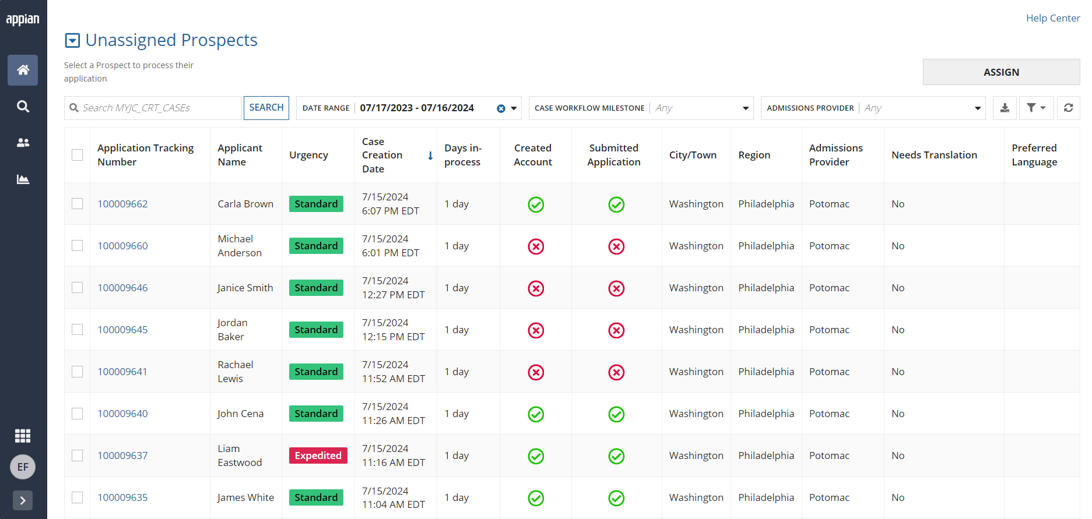
Enhanced Navigation
How has Gateway Navigation been enhanced?
Gateway Navigation is now located on the left side of the screen, featuring a collapsible side bar, This updated view maximizes screen space for viewing applicant information while being more scalable to multiple devices. You still have access to the same tabs and information.

Slide 4

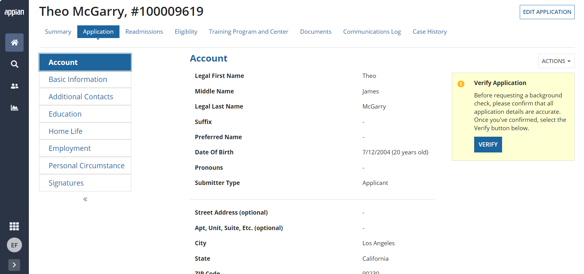
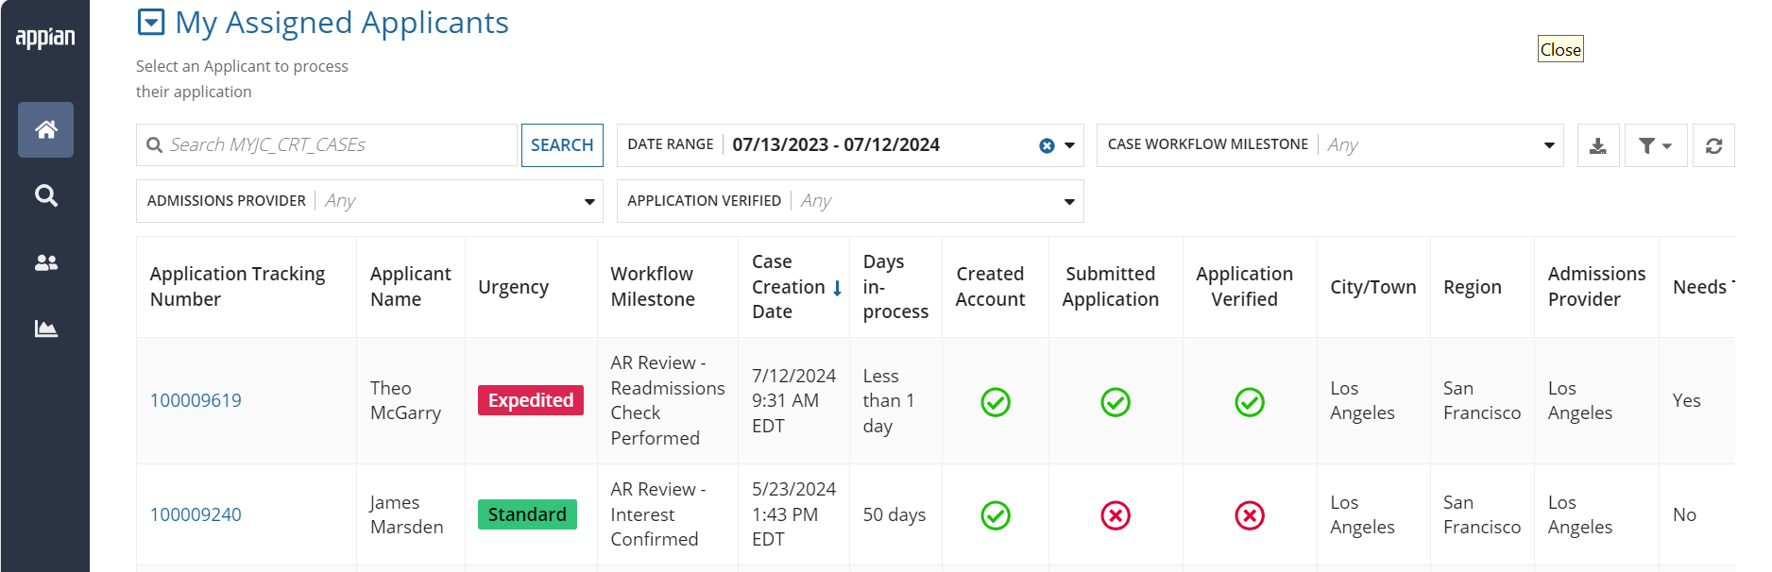
Application Verification
What is a Verified Application?
Gateway now features a new “Verified Application” status. This helps you distinguish between complete and accurate applications versus those that may still need a little work. When Admissions staff verify an application, the Application tile on the Case Summary tab updates to show the status as "Verified" and a green check mark will be visible under the column on the Home and All Cases tabs.
Applications need to be verified before requesting a background check.
Application Information will not display “Complete” until the application has been verified.

Slide 5

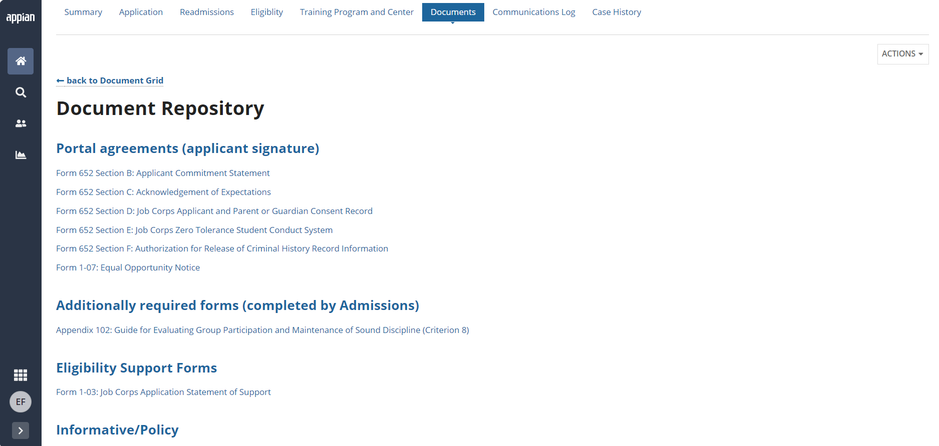
Document Repository
What is the Document Repository?
Admissions staff will be able to easily access and download blank forms from a centralized repository right from the Documents tab. It includes blank versions of Job Corps forms that require signature from applicants including the agreements that are available in Portal, and other policy documents that may be required after eligibility is determined.

Slide 6

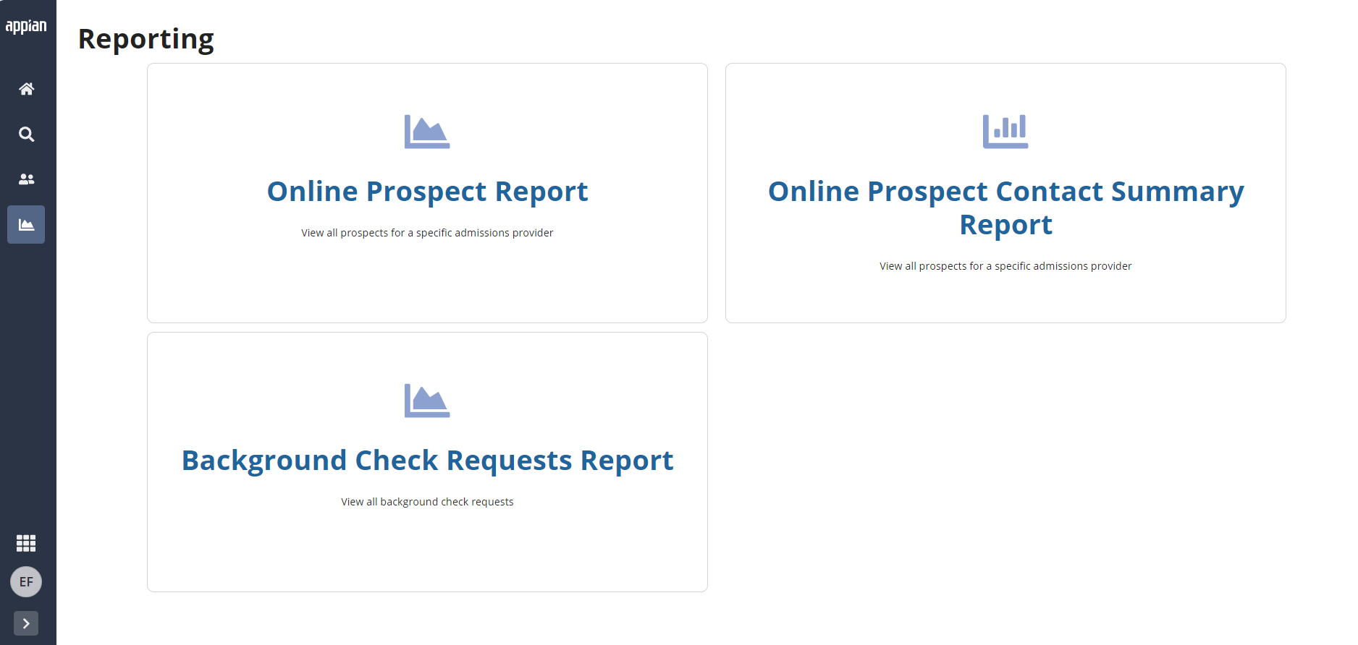
Updated Reporting
What is updating with Reporting in Gateway?
Gateway users will now to be able to view the Background Check Report. Users can view which cases a background check has been requested, making it easier to track the status of each request, monitor processing times, and ensure timely results. Additionally, Regional Directors have access to reports, tailored specifically to their region.

Slide 7

Questions

Slide 8
MyJobCorps
Thank you!
MyJobCorps Support Team
Office of Job Corps | JobCorps.gov
Employment & Training Administration (ETA)
U.S. Department of Labor
Email us at: MyJobCorps@dol.gov

