Slide 1
Micro-Training
3.2 Release
Last Updated: 09/19/2024

Slide 2
What to expect in the MyJobCorps 3.2 release
New Features and Enhancements will be available Friday, September 27th
Expedited Enrollment Case Processing in Gateway
Readmissions Check Enhancement
Updated Readmit Waiver Workflow
Refined Case Milestones
Enhanced Communications Log Experience
  Integration with Case Notes
  Applicant Customer Support Requests
New Reports in Gateway
  Application Summary
  Pending Arrivals

Slide 3
Processing Expedited Enrollment Cases in Gateway

Slide 4
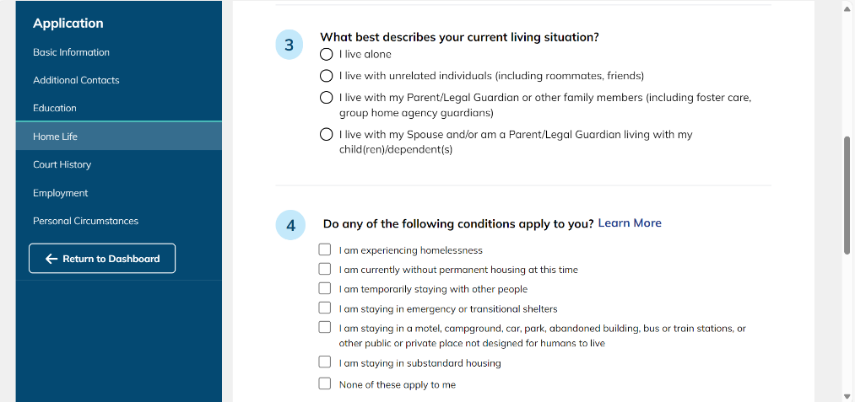


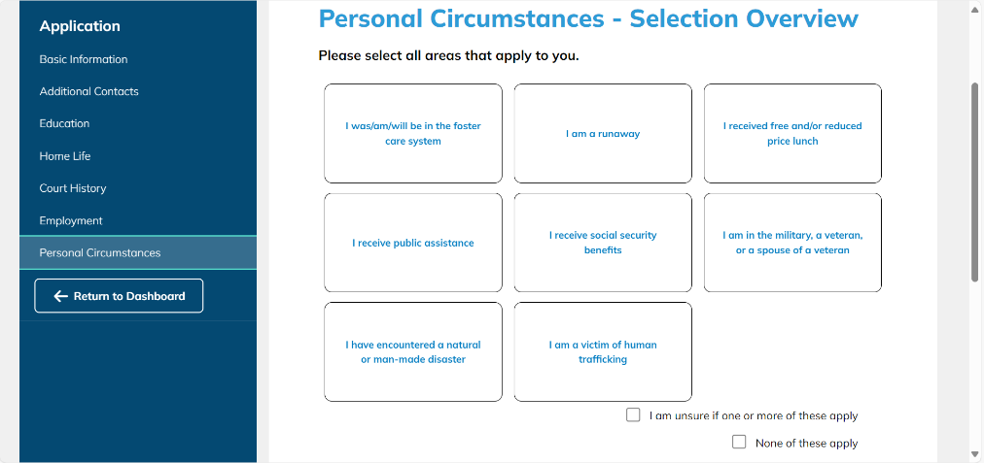

Applicants
How applicant data in MyJobCorps Portal trigger Expedited Enrollment criteria
Screenshots of Applicant Portal.
Homelessness
Any of the items marked in the "Home Life" section.
Victim of Human Trafficking
Selection marked in the "Personal Circumstances" section.
Natural or Man-Made Disaster
Selection marked in the "Personal Circumstances" section.

Slide 5
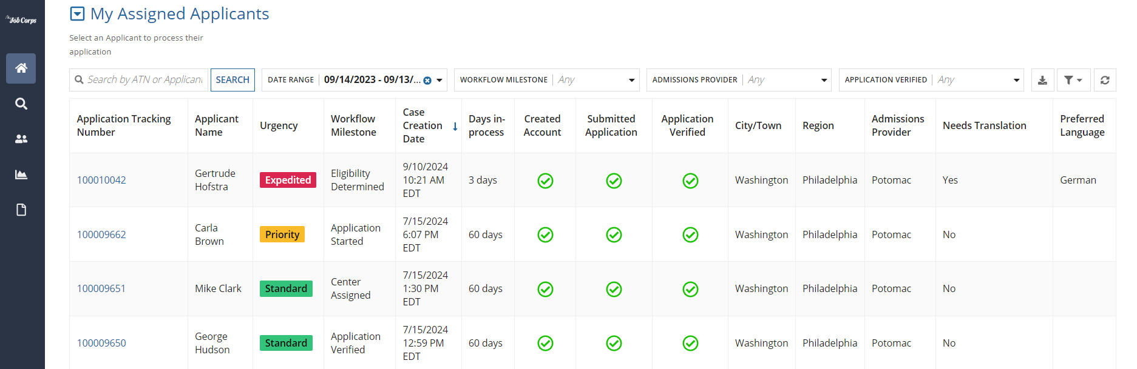
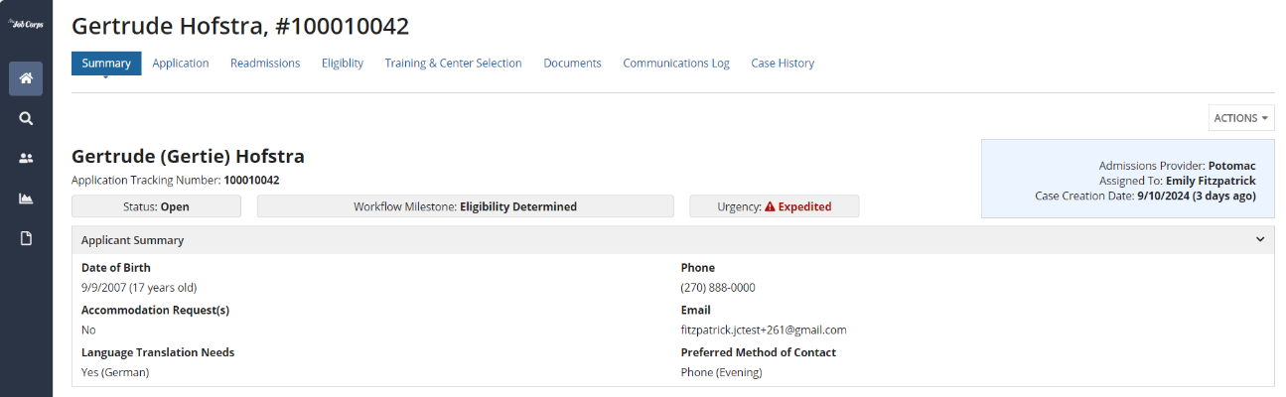
Admissions Staff
How to identify an Expedited Enrollment Cases in MyJobCorps Gateway
Screenshot of Gateway Home screen
If an applicant answered a question, or made a selection, in their submitted MyJobCorps Portal application that triggered Expedited Enrollment status, the urgency status in MyJobCorps Gateway will change from Standard to Expedited.
Admissions Staff can identify Expedited within the following views:
  The Home and All Cases view within in MyJobCorps Gateway.
  The expedited flag is visible on the Summary tab within the Applicant Record when staff click into an Applicant’s record.
Screenshot of Applicant Record view

Slide 6
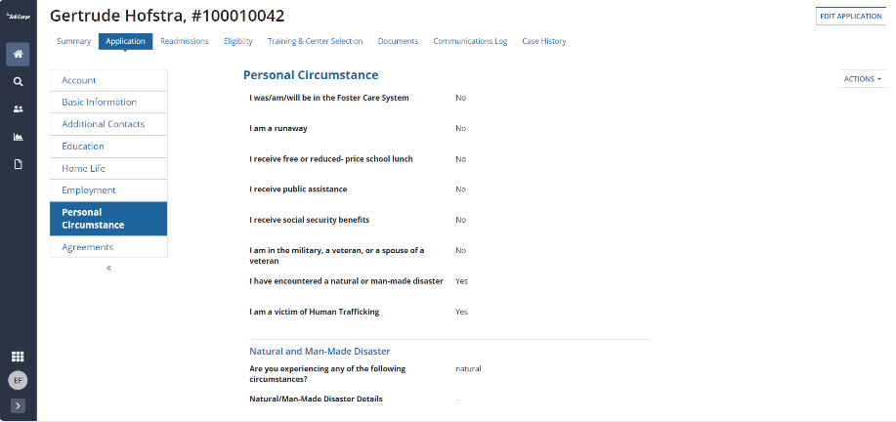
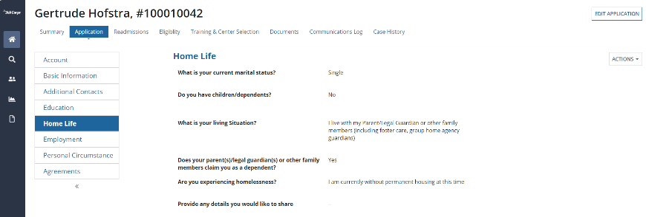
Admissions Staff
Reviewing and validating applicant data in MyJobCorps Gateway
Screenshots of a submitted application in Gateway
When applicants submit their MyJobCorps Portal application, their data is available in MyJobCorps Gateway within Application tab.
Admissions staff are responsible for reviewing and verifying applicant information. Verification is typically performed through interviews with applicants and reviewing their submitted documents, if any were uploaded.
If admissions staff need to make corrections for any data submitted by the applicant, they can unlock the case so the applicant can make edits in the MyJobCorps Portal or edit it on their behalf in MyJobCorps Gateway.
Notes:
Consider arrows to highlight the highlighted sections
Make sure to highlight those mirrored sections in gateway (as the applicant filled out in Portal)

Slide 7
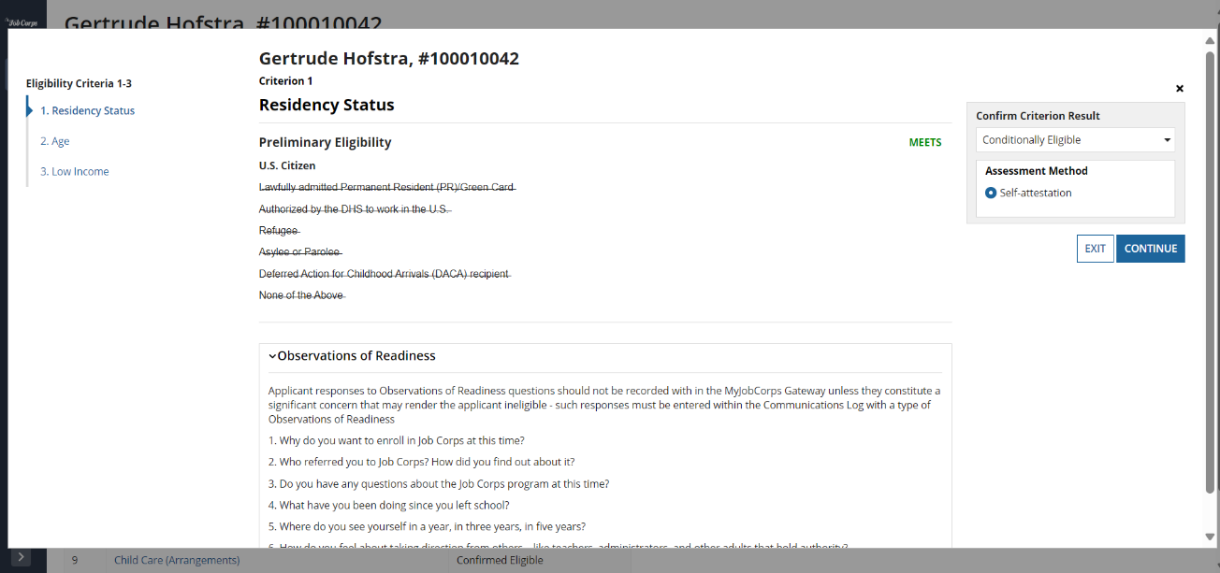
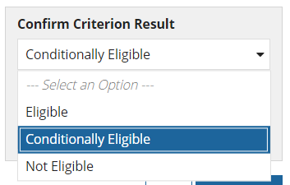
Admissions Staff
Processing Expedited Enrollment cases in MyJobCorps Gateway for Criteria 1-3
During or after an interview with the applicant, Admissions staff can proceed to assessing eligibility in MyJobCorps Gateway.
The following screens indicate how to mark an applicant as “conditionally eligible” for criterions 1-3. These three criterions must be marked as “conditionally eligible” (for self-attestation) or “eligible” (if documents are available) before requesting a background check.
Notes:
Define self attestation more clearly – the applicant “self-reports” the criteria – this allows for an applicant who is in need to be enrolled on center sooner
Emphasize it should give the applicant more time to collect/provide documents

Slide 8
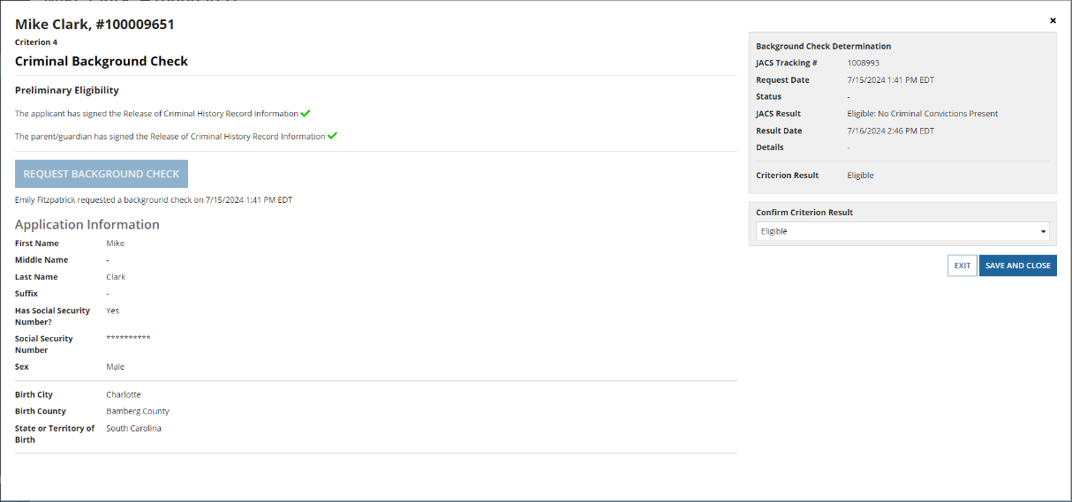

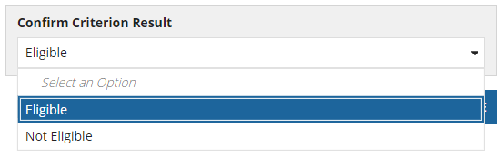
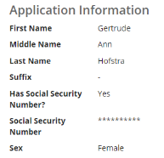
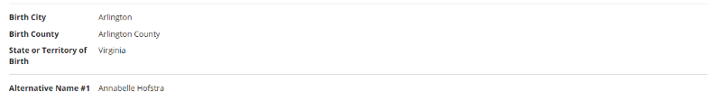
Admissions Staff
Requesting Background Checks for Expedited Enrollment cases in MyJobCorps Gateway for Criteria 4
Admissions staff should request background checks for Expedited Enrollment applicants the same way they do for Standard applicants.
When background check results are available, Admissions staff will automatically receive the result in MyJobCorps Gateway. They should immediately confirm the result in the Background Check Determination box and use the dropdown to indicate either Eligible or Not Eligible. There is not an option for conditionally eligible for Background Checks.

Slide 9
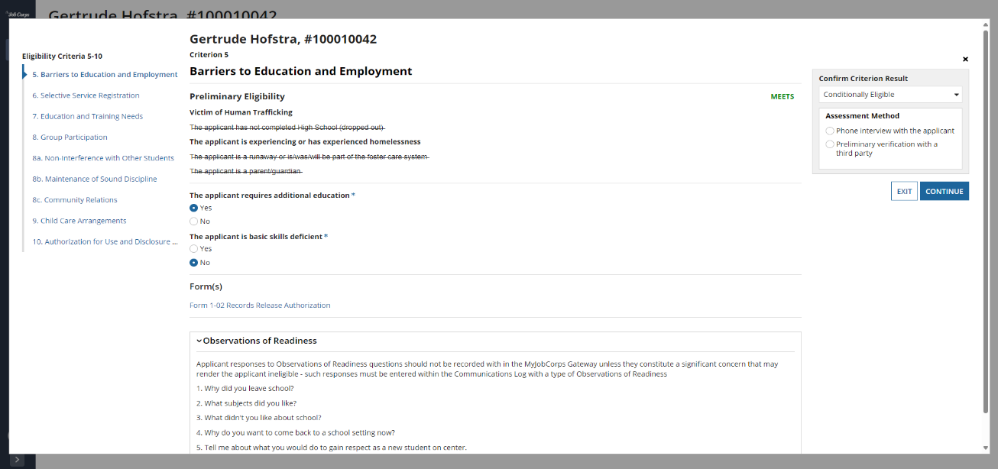
Admissions Staff
Processing Expedited Enrollment cases in MyJobCorps Gateway for Criteria 5-10
While waiting for the applicant’s background check results, Admissions staff should continue with eligibility processing for criterions 5-10 in MyJobCorps Gateway.
The following screens indicate how to mark an applicant as “conditionally eligible” for criterions 5-10. These criterions must be marked as “conditionally eligible” or “eligible” (if documents are available) to continue to QA Review.

Slide 10
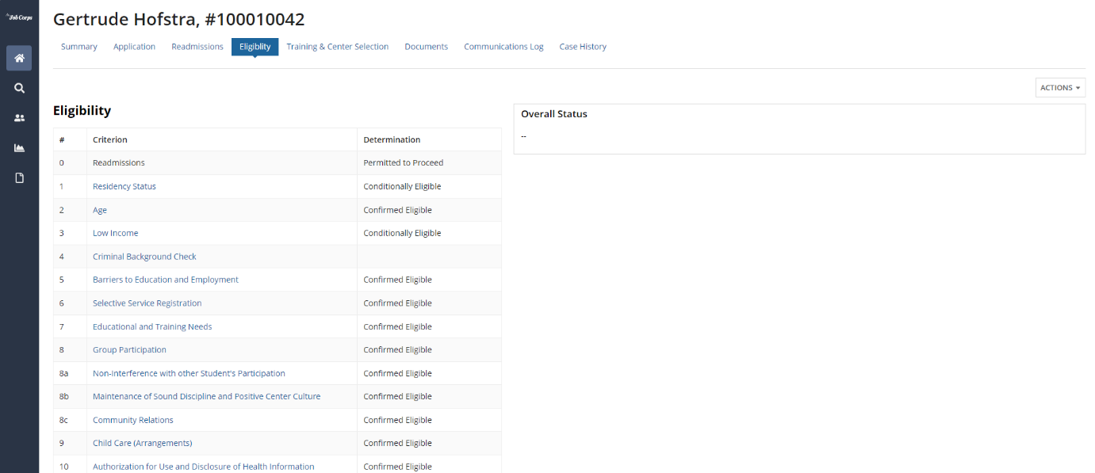

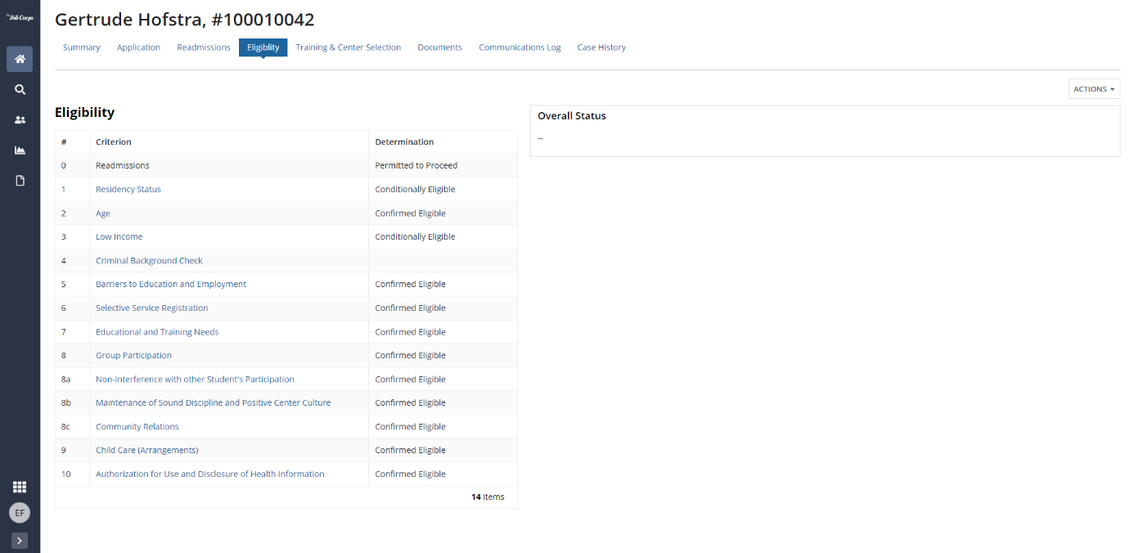
Admissions Staff
Reviewing the completed eligibility status in MyJobCorps Gateway for Criteria 1-10
If Admissions staff indicate Conditionally Eligible for at least one criteria, the overall eligibility status will display as “Conditionally Eligible” on the Eligibility page. The Admissions Representative should enter a case note that clearly defines the criteria that were marked as conditionally eligible.
Admissions staff will proceed to submitting the case for Quality Assurance (QA) review by their OA Manager.
When the OA Manager assigns the case to center, they must send an email to the Center Records Manager indicating that an expedited case has been submitted and routed to their queue.
Notes:
If an applicant is determined conditionally eligible, the Admissions Representative should enter a case note that clearly defines the criteria that were marked as conditionally eligible. This will inform the center records staff so they know to anticipate missing documents in E-Folder. This case note should be entered prior to submitting for QA Review.
When the OA Manager assigns the case to center, they must send an email to the Center Records Manager indicating that an expedited case has been submitted and routed to their queue, if desired

Slide 11
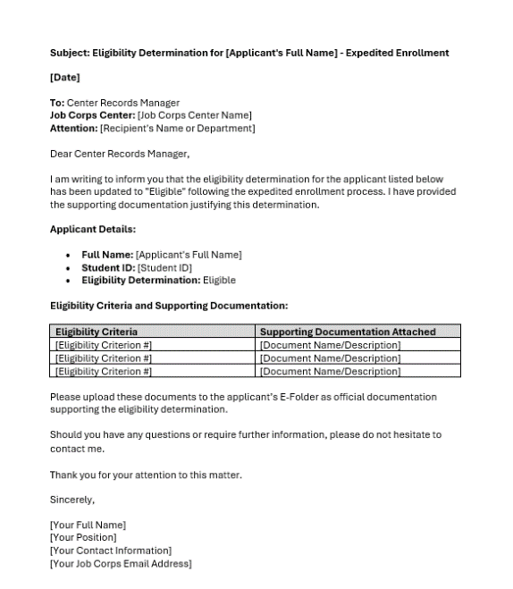
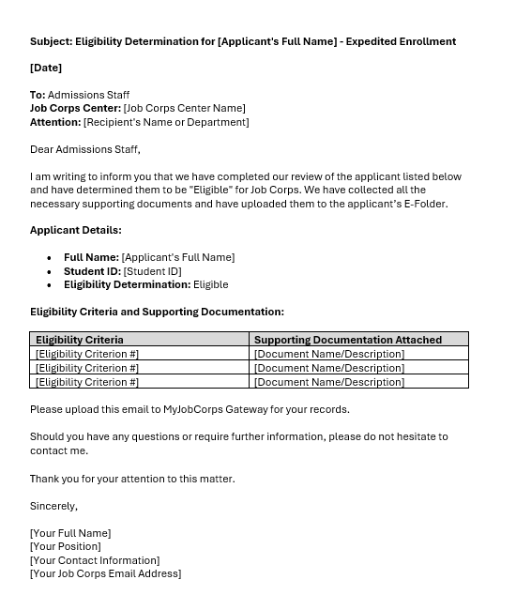
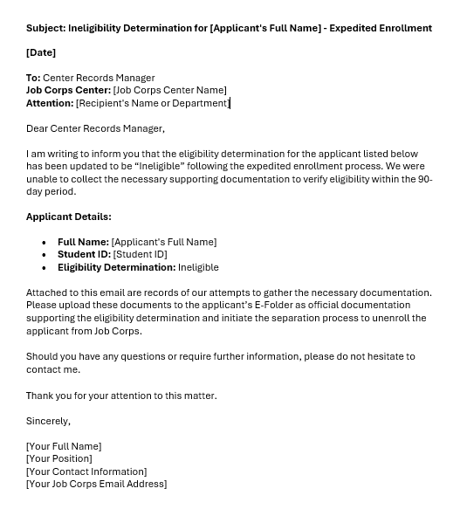
Admissions Staff
Confirming eligibility after a student has arrived on center
Admissions staff should continue to work with applicants to collect and review/approve any missing documentation for these criteria within 90 days of the applicant’s arrival date; updating the eligibility status for each criteria in Gateway.
If… | Then…
All documents are received and confirmed eligible | Update the applicant’s final eligibility in Gateway from “Conditionally Eligible” to “Eligible” and provide the updated documents. Using the provided template, notify the Center Records Manager of this change so they can take next steps in CIS.
All documents are received and confirmed NOT eligible | Update the applicant’s final eligibility determination from “Conditionally Eligible” to “Not Eligible.” Using the provided template, notify the Center Records Manager of this change so they can take next steps in CIS.
All documents were NOT received during the 90-day period | Update the applicant’s final eligibility determination from “Conditionally Eligible” to “Not Eligible.” Using the provided template, notify the Center Records Manager of this change so they can take next steps in CIS.
Notes:
If an applicant is determined conditionally eligible, the Admissions Representative should enter a case note that clearly defines the criteria that were marked as conditionally eligible. This will inform the center records staff so they know to anticipate missing documents in E-Folder. This case note should be entered prior to submitting for QA Review.
When the OA Manager assigns the case to center, they must send an email to the Center Records Manager indicating that an expedited case has been submitted and routed to their queue, if desired

Slide 12
3.2 Case Processing Enhancements and New Features

Slide 13
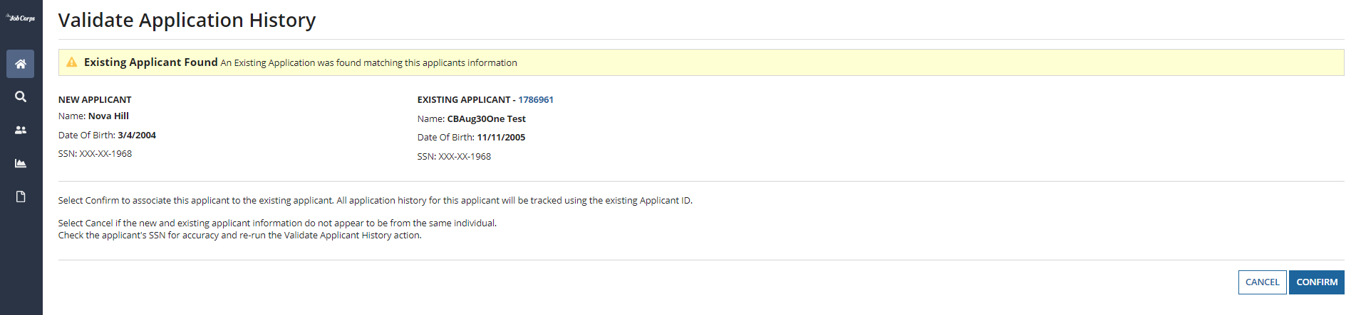
Readmissions Check
Admissions staff can now re-run the Readmissions Check (e.g. Check History) in MyJobCorps. The readmissions check verifies previous history using the social security number indicated in their application. If corrections were made to the social security number during case processing, Admissions Staff should re-run the readmissions check to re-verify their history with Job Corps.
Additionally, if the applicant submitted more than one application in MyJobCorps Portal, the readmissions check will prompt you to confirm that the two individuals are the same person. This updated feature gives Admissions Staff another layer of verification when handling duplicates
Alexandra Beacon-Hill

Slide 14
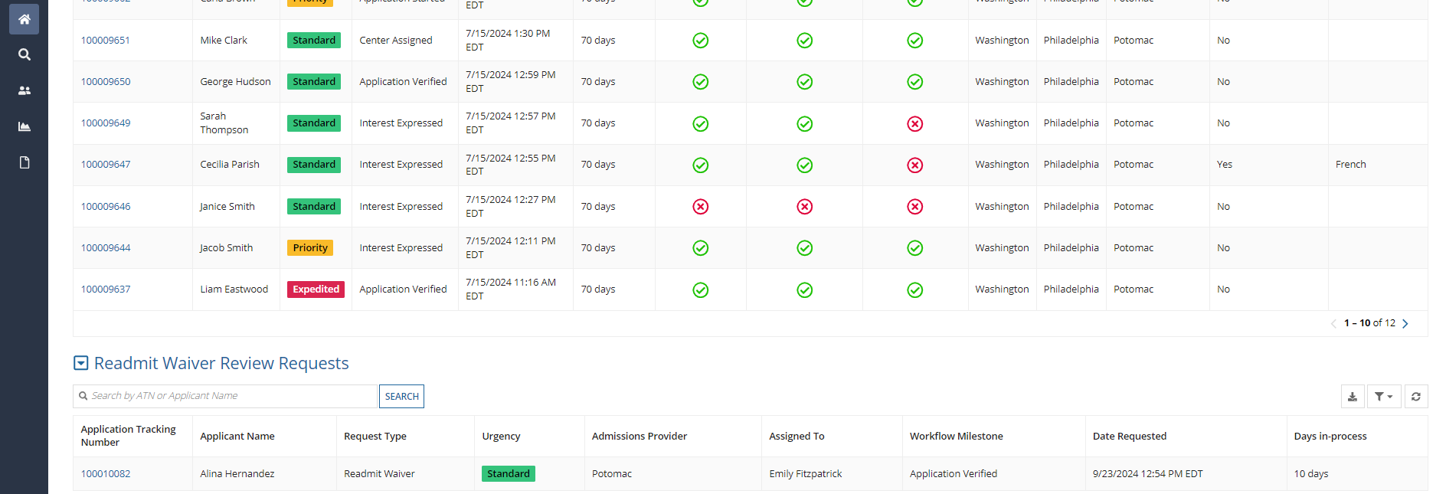
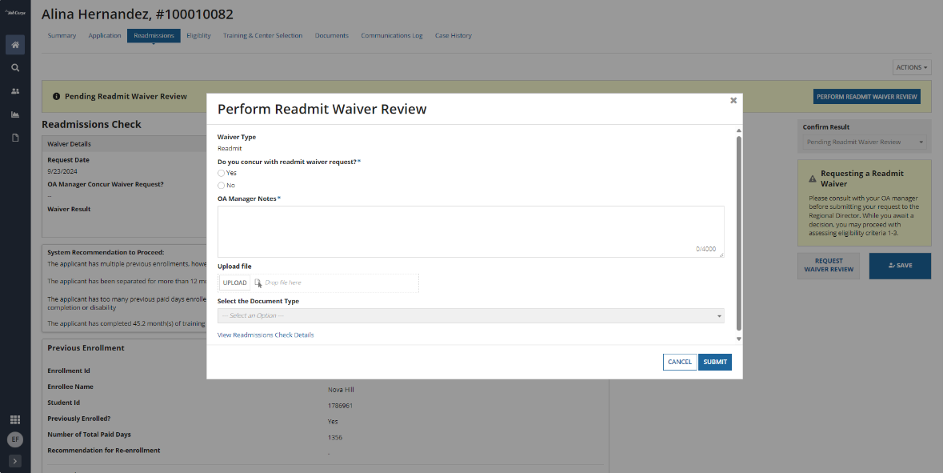
Routing Changes for Readmit Waivers
The readmit waiver workflow has been updated to route the request to an OA Manager before it is routed to the Regional Director for approval. OA Managers must carefully review the readmit waiver and work with Admissions Representatives to ensure the proper justification is provided before routing it for approval.
Notes:
“Regional Directors have requested this update to the readmit process in Gateway, this ensures an additional layer of review”

Slide 15
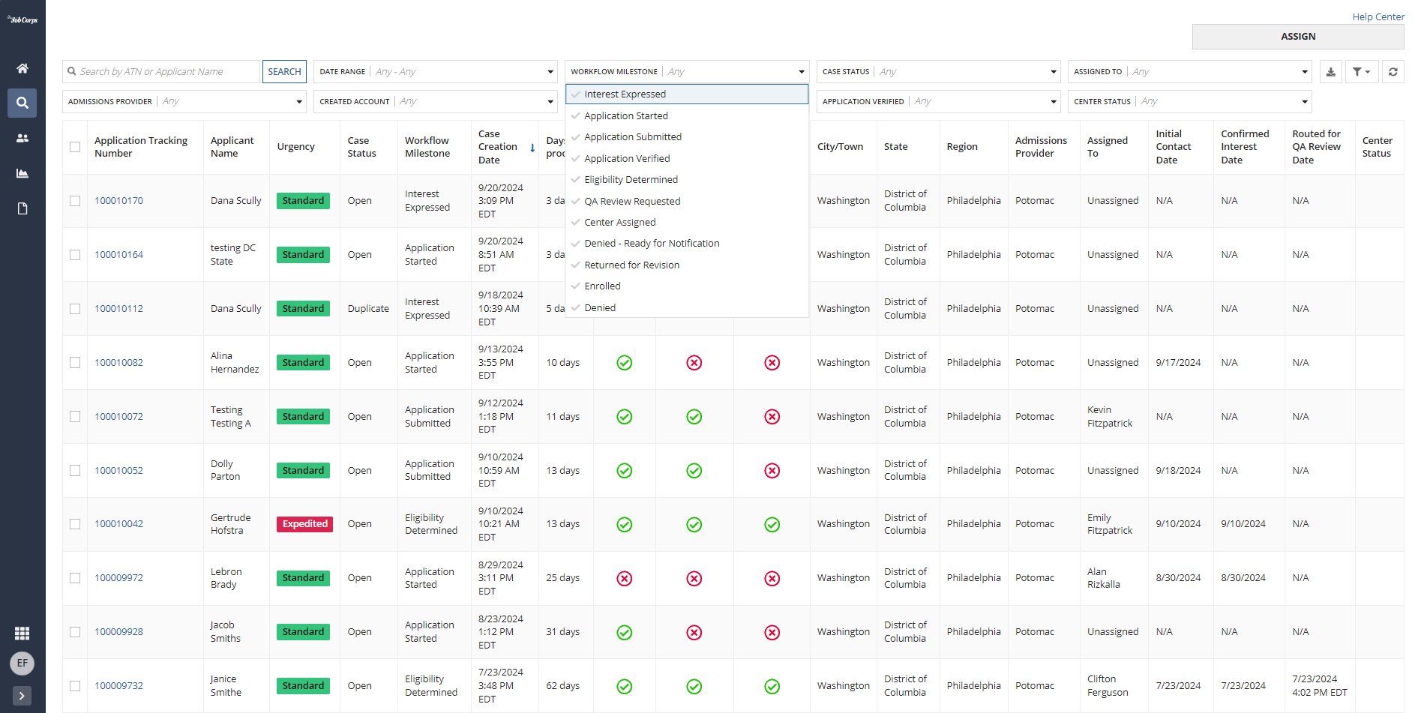
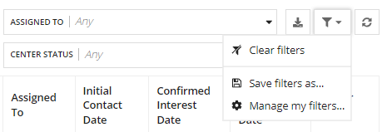
Case Milestones
Your case milestones have been updated and are visible in your Homepage and All Cases views. These case milestones provide detail into the steps within the admissions workflow. If you haven’t already, create custom filtered views and modify your previously saved custom filtered views to get quick snapshots into your workload.
Note: You will need to update any custom filters on your Home and All Cases tabs that utilize milestones.

Slide 16
Case Workflow Milestones Reference
Case Workflow Milestone | What the Milestone Means
Interest Expressed | The prospect has completed the Express Interest Tool (EIT) and has received automated instructions to begin their application.
Application Started | The applicant has registered an account through Login.gov and has begun their application within MyJobCorps Portal.
Application Submitted | The applicant has completed their application in Portal and submitted for review by their assigned AR.
Application Verified | The AR has reviewed the application and documents to verify completion and accuracy.
Eligibility Determined | The AR has determined eligibility of the applicant for the Job Corps program.
QA Review Requested | The AR has submitted the application and eligibility determination to their OA Manager for QA review.
Center Assigned | An application has been completed and assigned to a Job Corp Center to begin enrollment.
Denied - Ready for Notification | The applicant has been determined as ineligible for Job Corps. The AR should communicate to the applicant their denial and rationale.
Returned for Revision | The center has reviewed the application and deemed it necessary to return the application so the AR can make edits.
Enrolled | The applicant has been successfully enrolled at their Job Corps Center and the case has been closed.
Denied | The applicant has been denied enrollment in the Job Corp program and the case has been closed.

Slide 17
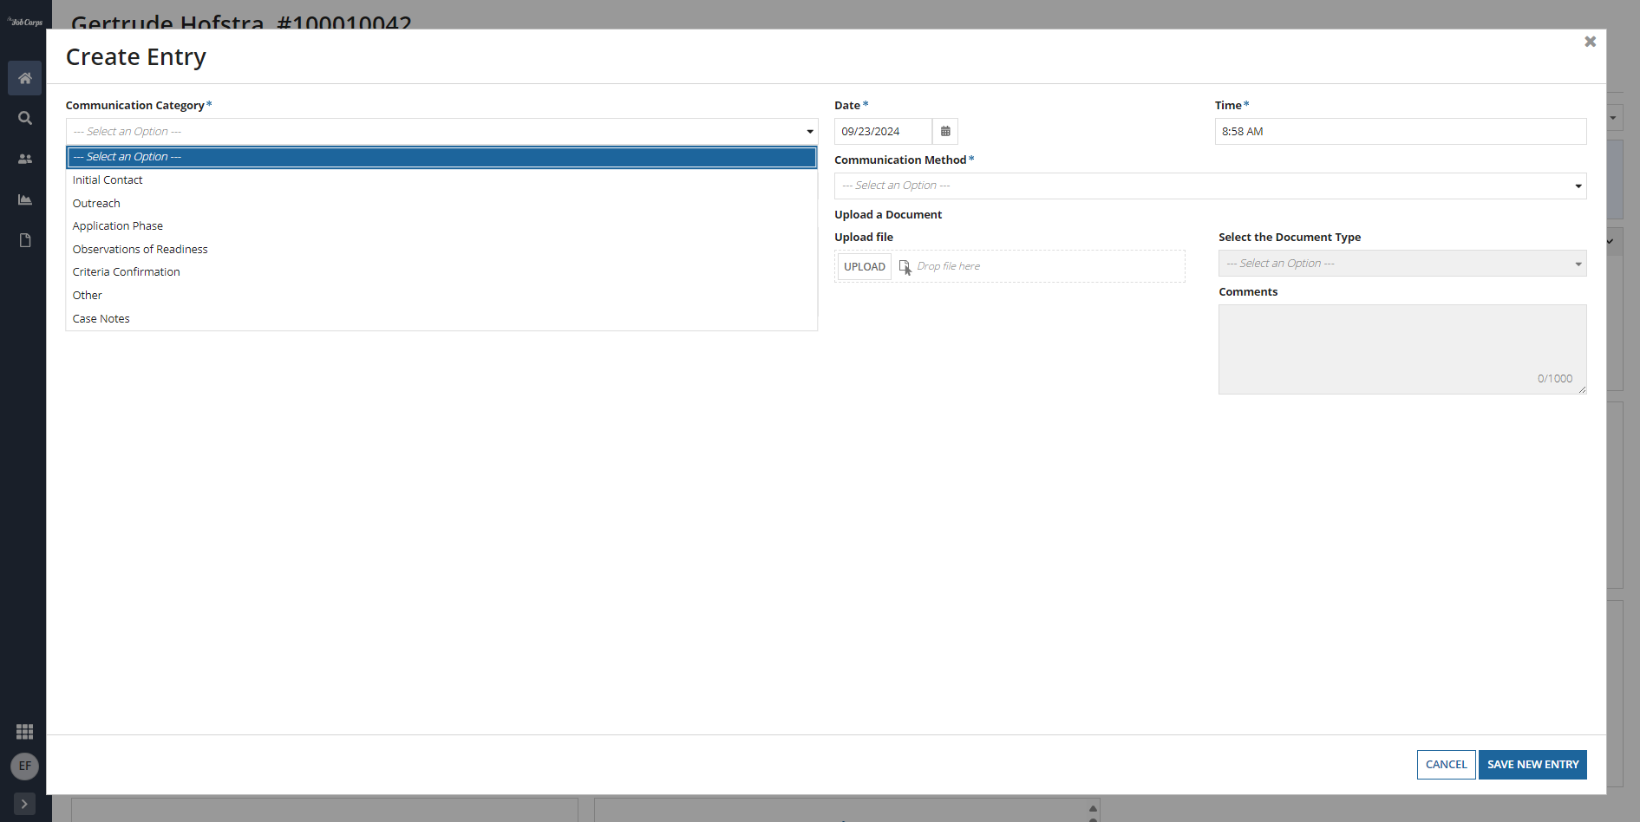
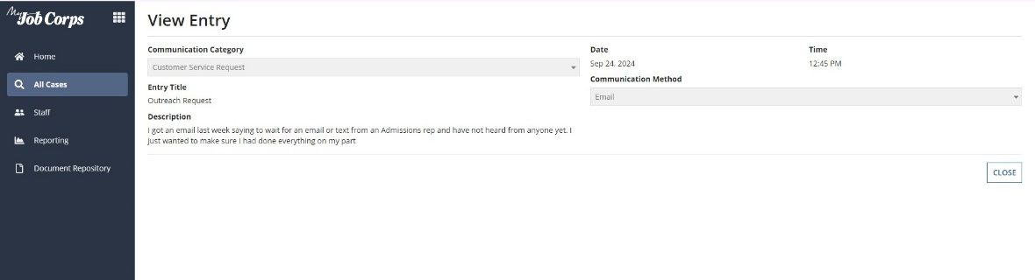
Enhanced Communications Log
Case Notes Integration:
Admissions staff can now add Case Notes from the Communications Log. When specifying a “Case Notes” entry in the Communication Log, the contents within that entry will automatically transfer to Case Notes at the conclusion of the case in MyJobCorps (e.g. assigned to a center).
Customer Support Requests:
When the MyJobCorps Help Desk receives a request from the public (e.g. applicant, parent, referrer), admissions staff will receive these notices via email and in the Communications Log under the new “Customer Support Request” category.

Slide 18
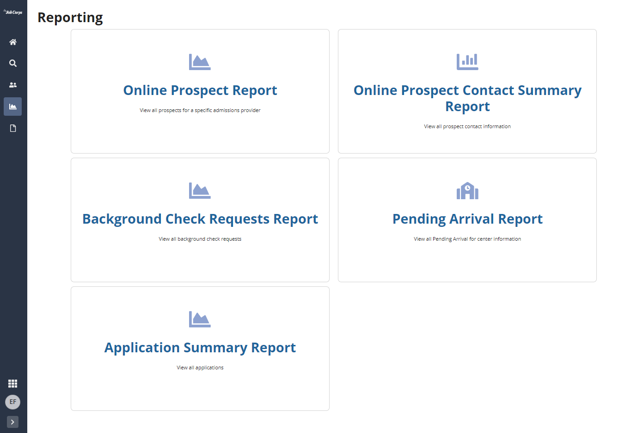
New Reports Available in Gateway
Application Summary
The Application Summary Report provides case totals for applications in progress, eligible, ineligible, and arrivals on center, with data segmented by sex.
Pending Arrivals
The Pending Arrivals Report provides data for applicants who have been assigned to a center but have not yet arrived, including their expected arrival dates.

Slide 19
Thank you!
MyJobCorps Support Team
Office of Job Corps | JobCorps.gov
Employment & Training Administration (ETA)
U.S. Department of Labor
Email us at: MyJobCorps@dol.gov

